Slide 1
Internet History
Internet Architecture
Who owns the Internet
-<number>

Slide 2
Internetworks and Internet
Many networks exist in the world
In order to establish a communication between "different" networks (hardware & software) there are gateways
A collection of interconnected networks is called internetwork or internet

Slide 3
Internetworks and Internet
The Internet is the network of networks which
  either use the TCP/IP protocol or
  can interact with TCP/IP networks via gateways
The Internet presents these networks as one, seamless network for its users
Internet is a particular internetwork

Slide 4
How did the Internet come to be?
It started as a research project to experiment with connecting computers together with packet switched networks.
It was developed with funding and leadership of the Defense Department’s Advanced Research Projects Agency (ARPA).
-<number>

Slide 5
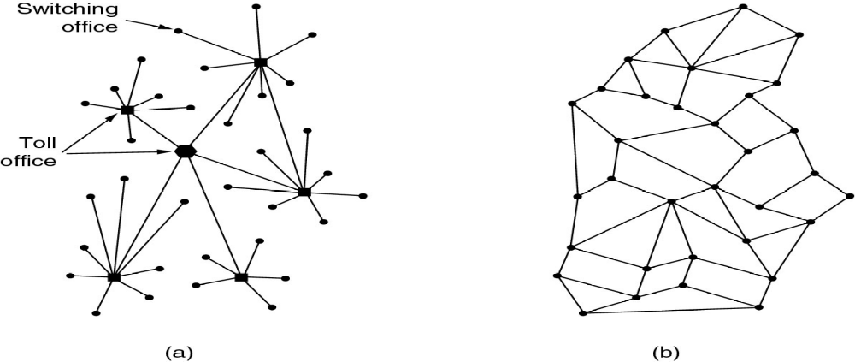
How did the Internet come to be?
At that time, there was only the telephone network
(a) Structure of the telephone
system – vulnerable!
(b) Baran’s proposed distributed
Switching system.

Slide 6
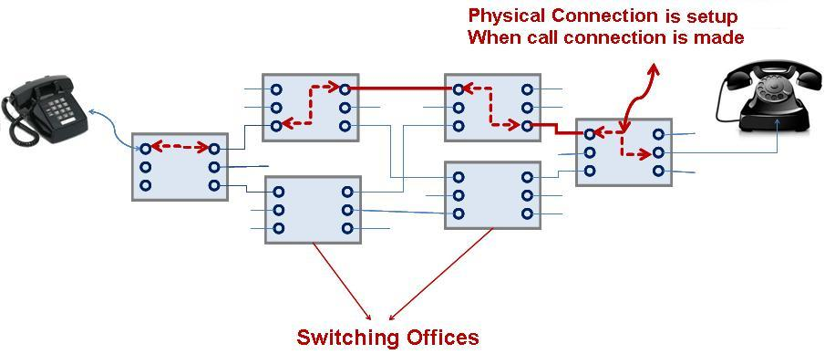
Communication Networks...
Telecommunication networks are ~100 years old
Circuit-switched, connection oriented
Intelligent core, dumb edge terminals

Slide 7
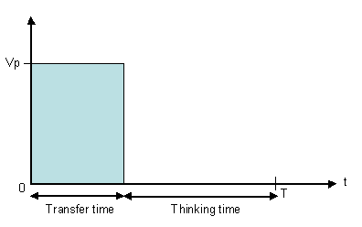
Data traffic is bursty – intervals of activity followed by periods of inactivity.
Circuit switched networks would be inefficient

Slide 8
Packet switching is attributed to three originators: Paul Baran, Donald Davies and Leonard Kleinrock.
Paul Baran had substantial influence on the decision to use packet switching for ARPANET
Donald Davies first applied the word ‘packet' to data communication, later built a small packet-switched network.
Leonard Kleinrock used queuing theory in the proposed packet switched networks.

Slide 9
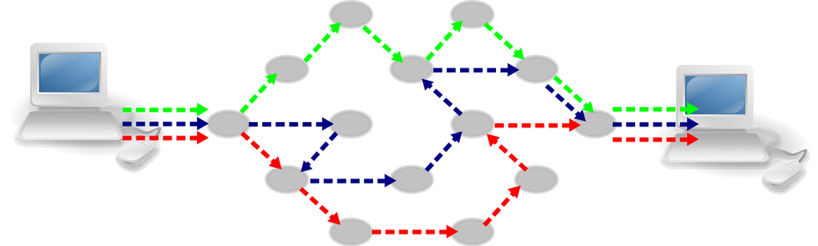
Packet Switching
More bandwidth efficient
Robust – not reliant on single route

Slide 10
1958-1961: Connect Computers?
1958-59 – Advanced Research Projects Agency was created within the Department of Defense (DoD)
  With a goal to establish US lead in science and technology applicable to the military
1961 – First published work on packet switching (“Information Flow in Large Communication Nets”, Leonard Kleinrock, MIT graduate student)
1964 – other independent works in packet switching at RAND Institute and National Physics Laboratory in England
-<number>

Slide 11
1966 –1968: Connect Computers?
1966 – Lawrence Roberts (colleague of Kleinrock from MIT) published overall plan for an ARPAnet, a proposed packet switch network
1968 – ARPA awarded contracts for four nodes in ARPANET to
  UCLA (Network Measurement),
  Stanford Research Institute (Network Information Center),
  University of California, Santa Barbara (Interactive Mathematics) and
  University of Utah (Graphics);
-<number>
Notes:
Colleagues on Kleinrocks from MIT go on to lead computer science program at ARPA
BBN = Bolt Beraneck and Newman Inc/
IMP = Interface Message Processors
Senator Edward Kennedy sends message to BBN congratulating on
Their million dollar ARPA grant to build the “Interfaith” Message
Processor and praising them for their ecumenical efforts ☺

Slide 12
1969: First Connections
7/4/1969 – First RFC (“Host Software” by Steve Crocker)
  to help record unofficial notes on the development of ARPANET
  basis for the Network Control Protocol(NCP)
2/9/1969 – Leonard Kleinrock’s computer at UCLA becomes first node on the ARPANET
Packet switches were needed - Interface Message Processors (IMP), the contract was awarded to BBN
Oct 1969: IMPs installed in UCLA, Stanford, UCSB and Utah
-<number>

Slide 13
The original ARPANET
IMPs (Interface Message Processors) are minicomputers connected by 56-Kbps transmission lines (the grandfathers of the routers)
Each IMP is connected with (at least) 2 IMPs
A host is connected to an IMP – it sends to it a message that is split into packets (1008 bits) forwarded independently to destination

Slide 14
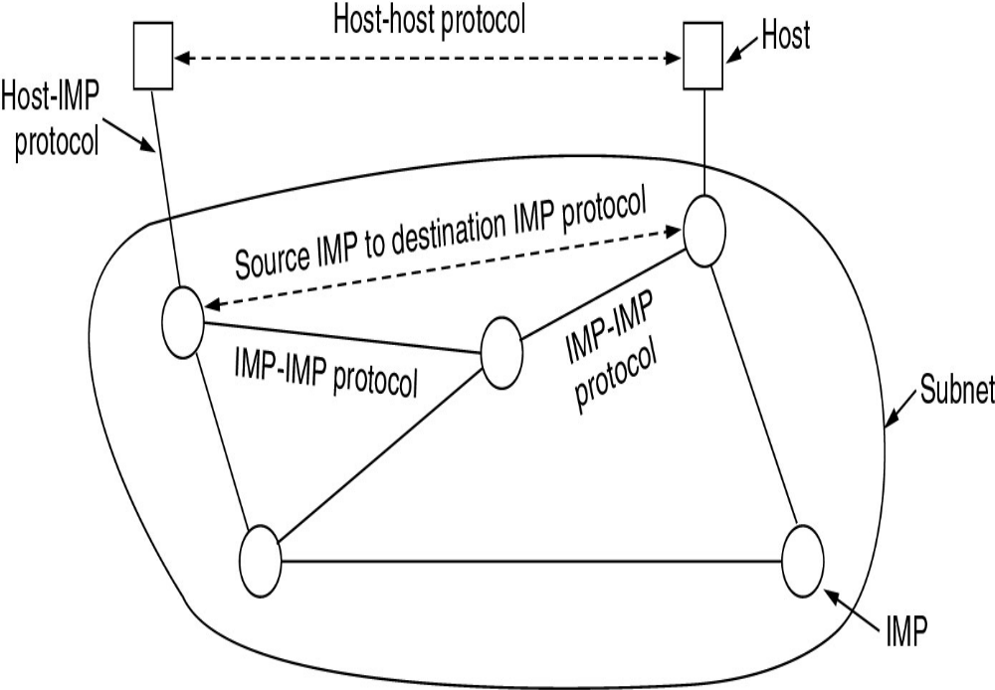

Slide 15
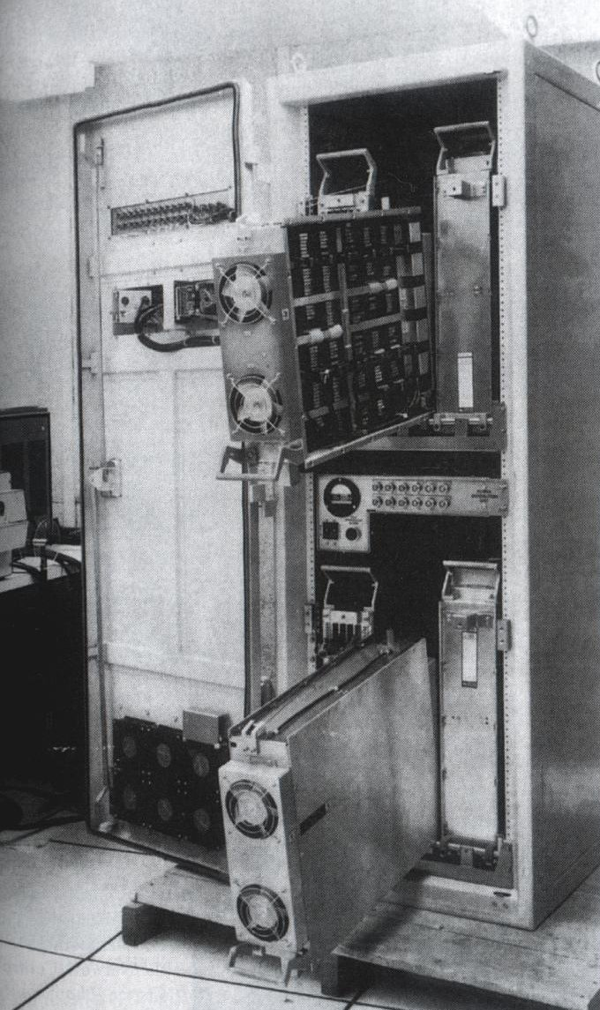
1969: First Connections
29/10/1969 – First packets sent; Charlie Kline attempted use of remote login from UCLA to SRI
-<number>

Slide 16
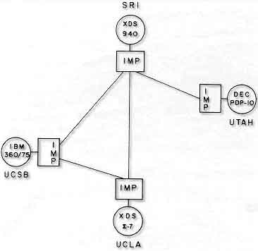
ARPANET
1969: At UCLA Kleinrock attempts the first ever remote login at Stanford:
"We set up a telephone connection between us and the guys at SRI...," Kleinrock said in an interview: "We typed the L and we asked on the phone,
"Do you see the L?"
"Yes, we see the L," came the response.
"We typed the O, and we asked, "Do you see the O."
"Yes, we see the O."
"Then we typed the G, and the system crashed"...

Slide 17
1967-1971: So what do we do with it?
1967-1972 – Vint Cerf, graduate student in Kleinrock’s lab, worked on application level protocols for the ARPANET (file transfer and Telnet protocols)
1971 - Ray Tomlinson of BBN wrote email application; derived from two existing: an intra-machine email program (SENDMSG) and an experimental file transfer program (CPYNET)
-<number>

Slide 18
Networks Growing
1970 - First cross-country link installed by AT&T between UCLA and BBN at 56kbps
1972-1974 – Robert Kahn and Vint Cerf developed protocols to connect networks without any knowledge of the topology or specific characteristics of the underlying nets
NCP, first host-to-host protocol, enables network applications
1972 – Robert Kahn gave first public demonstration of ARPAnet (now 15 nodes) at International Conference on Computer Communication
-<number>
Notes:
Initial ARPAnet was a single closed network – to communicate with an ARPA host one had to be attached to another ARPAnet IMP

Slide 19
Networks Growing
First computer to computer chat took place between Stanford and BBN
1972: Telnet protocol RFC published
1973: FTP protocol RFC published
1973-75 – Ethernet was designed in 1973 by Bob Metcalfe at Xerox Palo Alto Research Center (PARC)
Bob Metcalfe's doctoral dissertation led to the Ethernet protocol
Dissertation initially rejected by Harvard for not being analytical enough, but won acceptance when a few more equations were added!

Slide 20
Proprietary Networks
ARPANET was a standalone network.
Other proprietary, standalone networks were created in the 70s:
ALOHANET: Linking Hawaiian universities, using microwave as transmission medium
Telenet: by BBN, commercial
Cyclades: French packet switching network
Number of networks was growing!
At DARPA, Vinton Cerf and Robert Kahn were working on an architecture to create a “network of networks” - internetting!

Slide 21
“Internetting” principles
Decentralized control
Stateless routers
Autonomy - networks should be independent, require no modification to participate in the Internet
Best Effort Service Model - Packets would be routed through the fastest available route

Slide 22
1974-1978: Development of TCP/IP
1974 – First full draft of TCP produced
November 1977 - First three-network TCP/IP based interconnection demonstrated linking SATNET, PRNET and ARPANET in a path leading from
  Menlo Park, CA to
  Univ. College London and back to
  USC/ISI (Marina del Ray, CA)
1978 – TCP split into TCP and IP
-<number>

Slide 23
1981 –1984:
Base Protocols In Place
1981 – Term “Internet” coined to mean collection of interconnected networks
1982 – ISO releases OSI seven layer model; actual protocols die but model is influential
1/1/1983 – Original ARPANET NCP was banned from the ARPANET and TCP/IP was required
-<number>

Slide 24
TCP and UDP
Early versions had in sequence delivery (transport layer) combined with forwarding (network layer)
It was soon apparent that unreliable, non-flow controlled service was important, e.g. packetized voice
This led to separation of TCP and IP and creation of the UDP protocol.

Slide 25
1983-1986: Not Just a Research Project Anymore
1983 – ARPANET split into ARPANET and MILNET;
    MILNET to carry defense related traffic
1984 – Domain Name System introduced;
  1000+ hosts (200 hosts by end of 1970s; over 100,000 by end of 1980s)
1986 – NSFNET created to provide access to 5 super computer centers including Theory Center at Cornell (NSFNET backbone speeds 56 Kbps)
-<number>
Notes:
: Open up to academics worldwide for real work

Slide 26
1988-1989: Growing Pains?
1988 - Nodes on Internet began to double every year
November 1988 – Internet worm affecting about 10% of the 60,000 computers on the Internet (Robert Morris, Cornell)
1988 - Internet Assigned Numbers Authority (IANA) established in December
-<number>
Notes:
1989 – Link between Australia’s AARNET and NFSNET
1989 – was this first link outside US – no? Link to univ college London?

Slide 27
1990-1993:
WWW Explosion
1990 – ARPANET ceased to exist
1990 – Tim Berners-Lee developed hypertext system with initial versions of HTML and HTTP and first GUI web browser called “WorldWideWeb”
1993 – Mosaic, a GUI web browser, written by Marc Andreessen and Eric Bina at NCSA took world by storm (showed in-line images and was easy to install);
WWW proliferated at a 341,634% annual growth rate of service traffic
-<number>

Slide 28
1990-1993:
WWW Explosion
1990 – First ISP world.std.com
1991 – NSFNET lifted restrictions on use of NSFNET for commercial purposes
1992 – Internet Society founded
NSFNET began to serve as backbone, linking regional networks in US and networks abroad
NSFNET was decommissioned in 1995, most Internet backbone traffic carried by commercial ISPs
Increased commercialization, advent of WWW, all lead to explosion of growth
-<number>

Slide 29
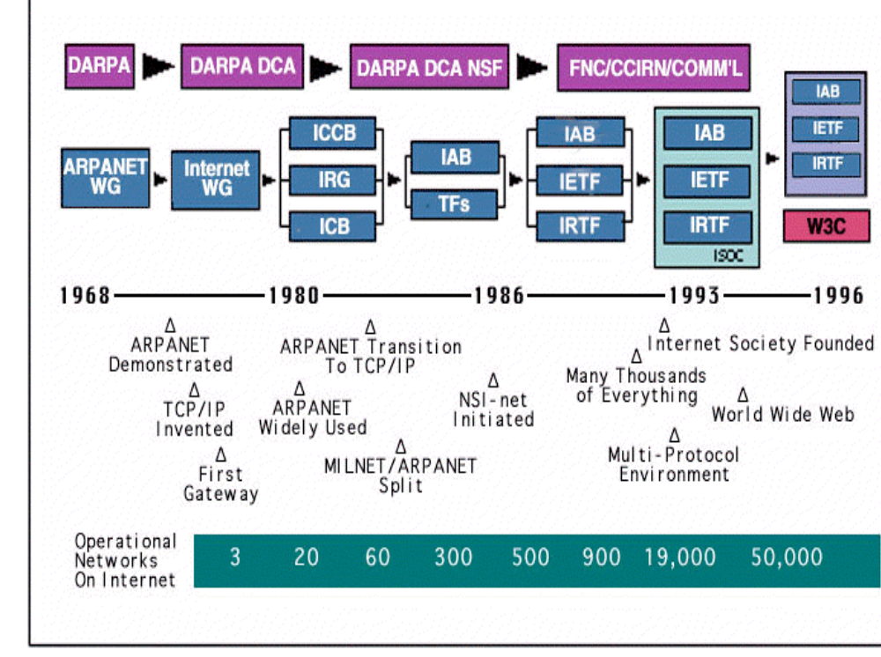

Slide 30
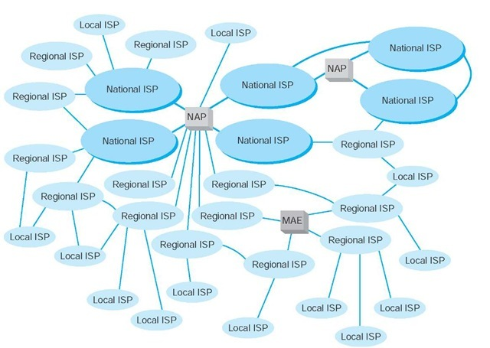

Slide 31
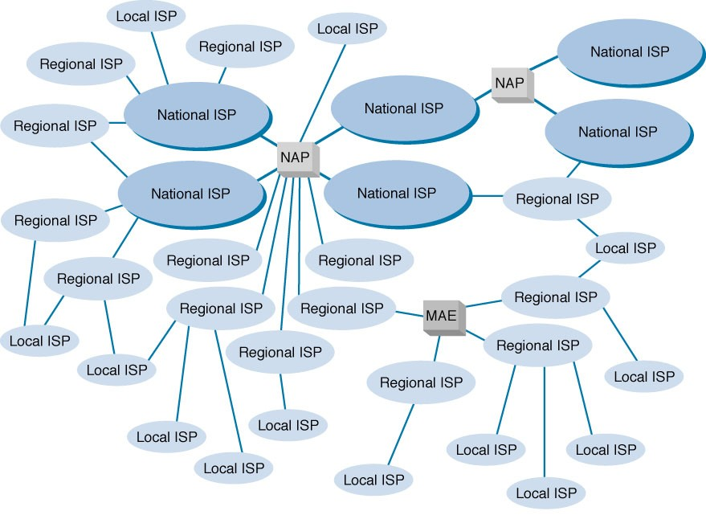
pop
pop
pop
pop

Slide 32
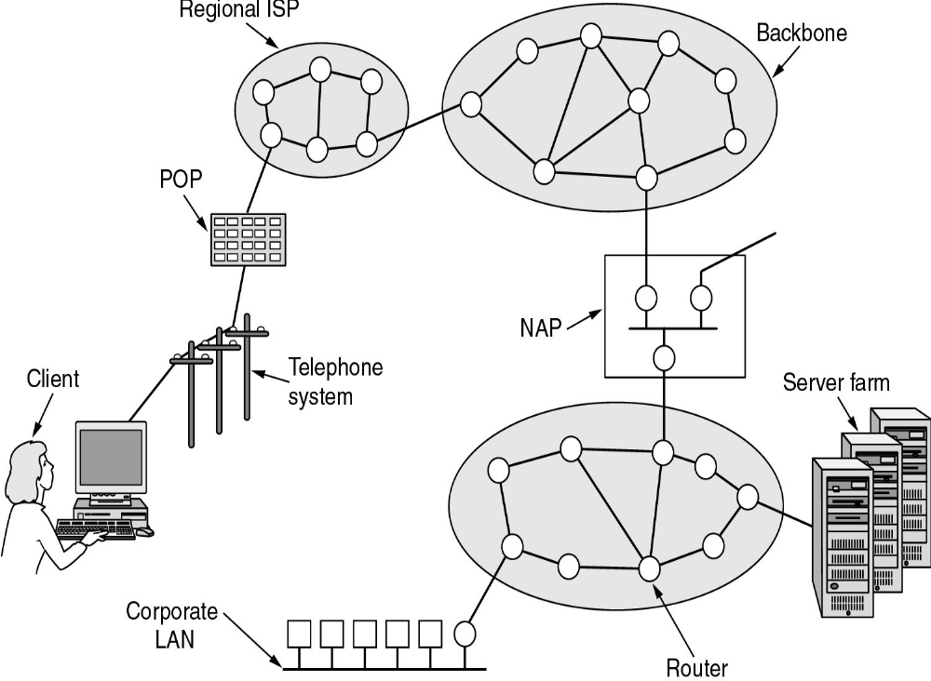

Slide 33
Important Terms
ISP (Internet Service Provider): business or organization that provides consumers or businesses access to the Internet and related services
NAP (Network Access Point): 4 Network access points where a packet switches from one backbone to another.
MAEs (metropolitan area exchange) are smaller versions of NAPs and typically link a set of regional ISPs whose networks come together in major cities

Slide 34
Important Terms
POP (Point of Presence): an access point to the Internet. It is a physical location that houses servers, routers, ATM switches and digital/analog call aggregators
Backbone: a large collection of interconnected commercial, government, academic and other high capacity data; routes and core routers that carry data across the countries, continents and oceans of the world

Slide 35
Internet service providers (ISPs)
Local ISPs- Tier 3 (cablevision)
Regional ISPs – Tier2 (Bharti Airtel, Reliance Globalcom)
Global ISPs (verizon, Sprint, ATT, Tata Communications, Deutsche Telekom) provide access to entire internet; connect ISP to other ISPs – Tier 1
Peering ISPs – Have a mutual relationship about forwarding traffic of each other’s customers (no $ involved)
Transit ISPs – Provides access to all reachable customers ($$ involved)

Slide 36
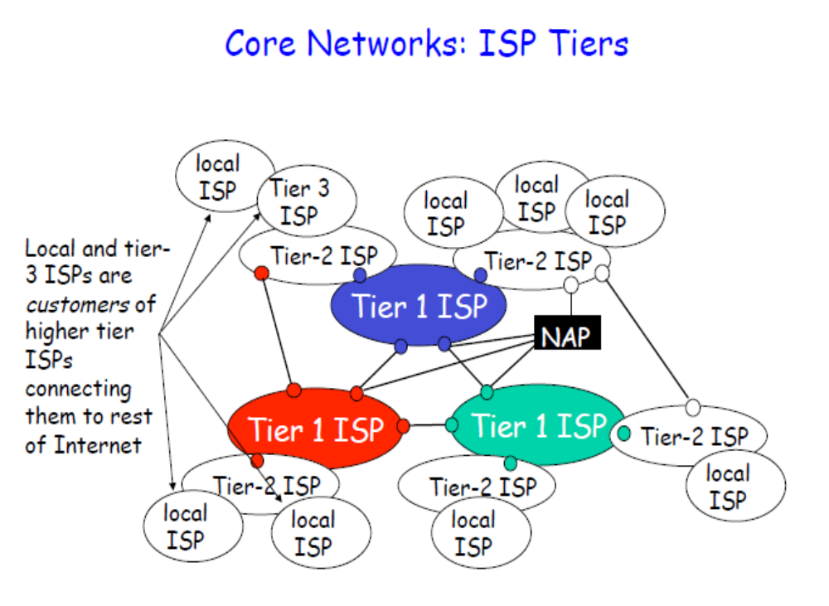

Slide 37
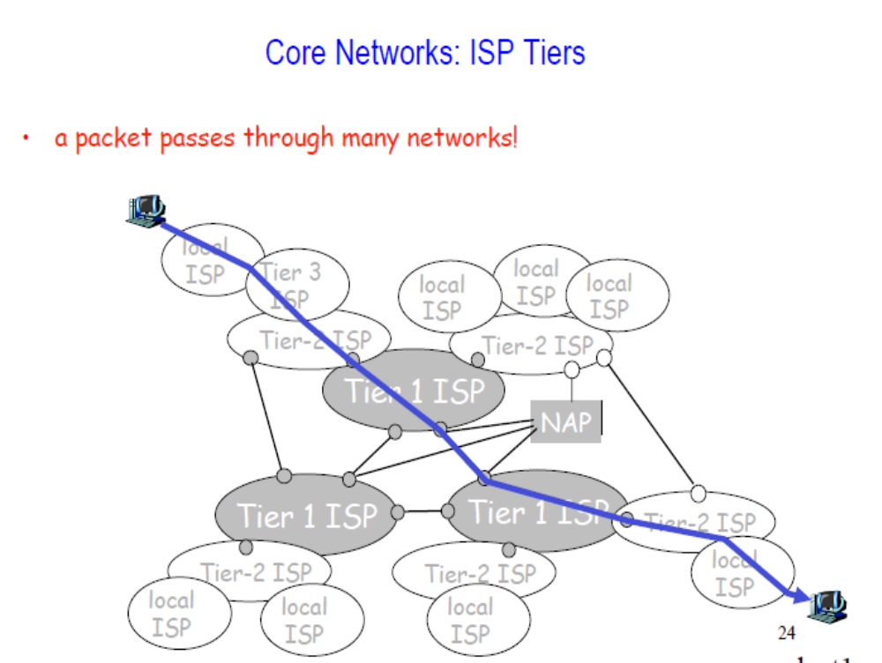

Slide 38
Who owns the Internet?
Nobody
The Internet has global reach and integrity, and is not constrained in terms of supported services and applications
The Internet is for everyone there is no central authority that designates or permits different classes of Internet activities
The Internet requires some basic agreements and social behavior between technologies and between human
Although no specific technology defines the Internet, there are some basic characteristics that describe what works
And, finally, the more the Internet stays the same, the more it changes

Slide 39
Who owns the Internet?
Why organizations / bodies are
needed?
Define protocol specifications
Agree on a process for standards
Specify the rules of the IP resources allocation

Slide 40
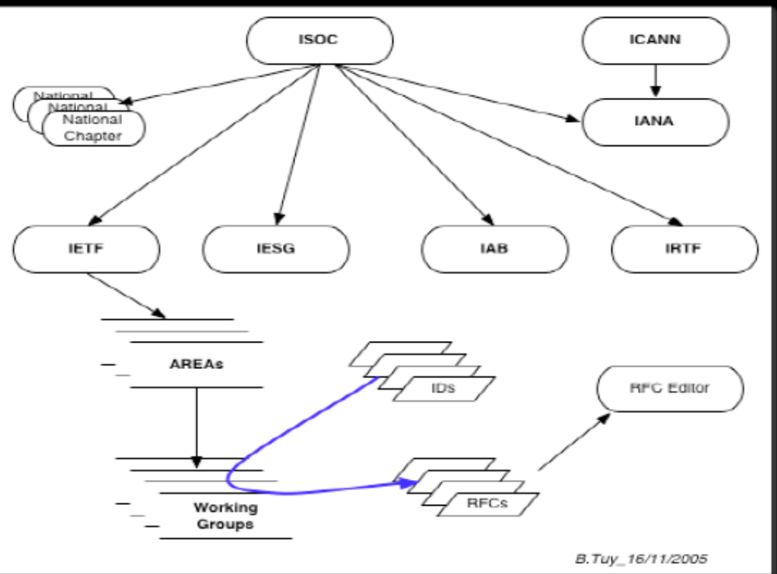

Slide 41
Who controls the Internet
Internet Corporation for Assigned Names and Numbers (ICANN), based in Marina Del Rey, California
  regulates online addresses (domain names), and their suffixes, such as ".com" and ".org"
  reports to the US government's Department of Commerce
  Any changes carried out at the "top" level – (e.g. adding new country-level suffixes) have to be checked by the US Department of Commerce
  the actual implementation of the change is carried out by Verisign, a US-based private company that manages the root name database, which contains the full official list of recognised suffixes.

Slide 42
Who controls the Internet
The Internet Society (ISoc) is an international, non-profit organization founded in 1992 to provide leadership in Internet related standards, education, and policy
  Headquarters in Reston, Virginia, United States and offices in Geneva, Switzerland.
  membership base of more than 130 organizations and more than 55,000 individual members.

Slide 43
Who controls the Internet
The Internet Society is the parent corporation of the Internet Engineering Task Force (IETF)
  IETF develops and promotes voluntary Internet standards, in particular the standards that comprise the Internet protocol suite (TCP/IP)
  It is an open standards organization
  All IETF Request for Comments documents, including those RFCs which describe "Internet Standards", are copyrighted by the Internet Society

Slide 44
1, 47, 71, 11, 61, 32, 85, 80, 76, 20, 70, 28, 43, 6, 79

Slide 45
Who controls the Internet
The Internet Engineering Steering Group (IESG) is a body composed of the IETF chair and area directors
It provides the final technical review of Internet standards and is responsible for day-to-day management of the IETF
Members of the IESG include directors of the following areas:
Applications Area (app)
Internet Area (int)
Operations & Network Management Area (ops)
Routing Area (rtg)
Real-time Applications and Infrastructure Area (rai)
Security Area (sec)
Transport and Services Area (tsv) - frequently also referred to as the "Transport Area"

Slide 46
Who controls the Internet
The Internet Architecture Board (IAB) is the committee charged with oversight of the technical and engineering development of the Internet by the Internet Society (Isoc)
Responsibilities of IAB
Architectural Oversight: aspects of the architecture for the network protocols and procedures used by the Internet.

Slide 47
Who controls the Internet
Responsibilities of IAB
Standards Process Oversight and Appeal: the process used to create Internet Standards. The IAB serves as an appeal board for complaints of improper execution of the standards process
Request for Comments series: The IAB is responsible for editorial management and publication of the Request for Comments (RFC) document series.

Slide 48
Who controls the Internet
Responsibilities of IAB
Internet Assigned Numbers Authority: In conjunction with the Internet Corporation for Assigned Names and Numbers (ICANN), the IAB is responsible for administration of the assignment of IETF protocol parameter values by the Internet Assigned Numbers Authority (IANA).

Slide 49
Who controls the Internet
Responsibilities of IAB
Advice to the Internet Society: The IAB acts as a source of advice and guidance to the Board of Trustees and Officers of ISOC concerning technical, architectural, procedural, and (where appropriate) policy matters pertaining to the Internet and its enabling technologies.

Slide 50
Who controls the Internet
Responsibilities of IAB
Internet Engineering Steering Group Confirmation: The IAB confirms the IETF Chair and IESG Area Directors
Internet Research Task Force Chair: The IAB selects a chair of the IRTF for a renewable two year term..

Slide 51
How to Make the Internet a Lot Faster
Feb. 2010 - Google announced its plans to build an experimental fiber network that would offer gigabit-per-second broadband speeds to U.S. homes
This will make possible: transfer of very large files, streaming high-definition (and possibly 3-D) video, video conferencing, and gaming
BUT the transmission control protocol (TCP), the 20-year-old algorithm that governs most of the traffic flow over the Internet, doesn't work well at gigabitper-second speeds
In order to make sure that it does not lose data, it uses too little of the bandwidth available (Steven Low, Caltech).

